Slide 1




Computer Science Student: Tommy Ju Teacher: Ms. Lawrence

Slide 2
Table of Contents
Cover Page...............................................................1
Formal Proposal......................................................3
Capstone Timeline...................................................4
Logs for Vertex and Quadratic Calculators................5
Logs for Triangle Solver Program......................6, 7, 8
Goals.......................................................................9
Resume & Cover letter............................................10
Reference Letters....................................................11
Final Reflection......................................................12
Core Competencies.................................................13

Slide 3
Formal Proposal
Formal Proposal Word Document

Slide 4

Capstone Timeline
Due Date: December 13 2019
Oct. 17 – Research and develop flow charts for Vertex form converter and Quadratic Formula Calculator.
Oct. 30 – Code and debug program using flow charts as references.
Nov. 2 – Research modules that can be used to solve triangles and create a flowchart for the Triangle Solver program.
Dec. 11 – Finish Coding and debugging the Triangle Solver, create a GUI if done planning before Nov. 20

Slide 5
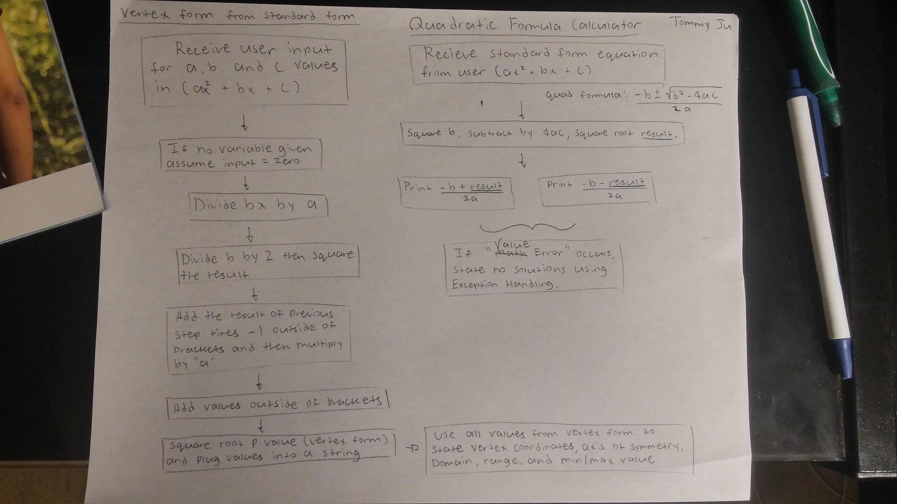
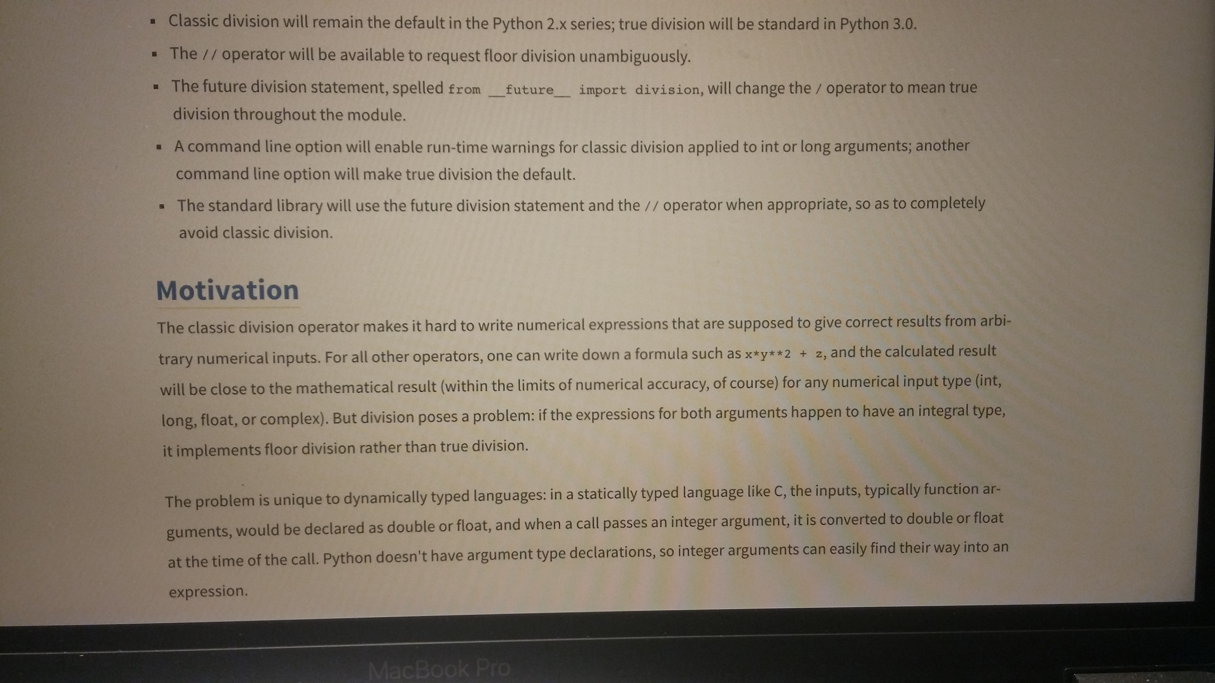
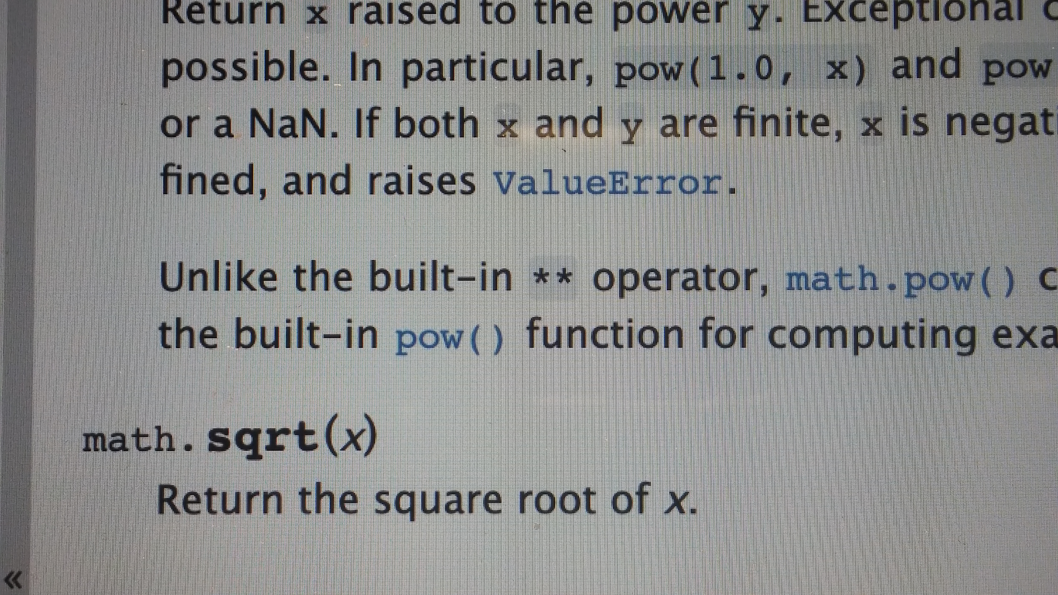
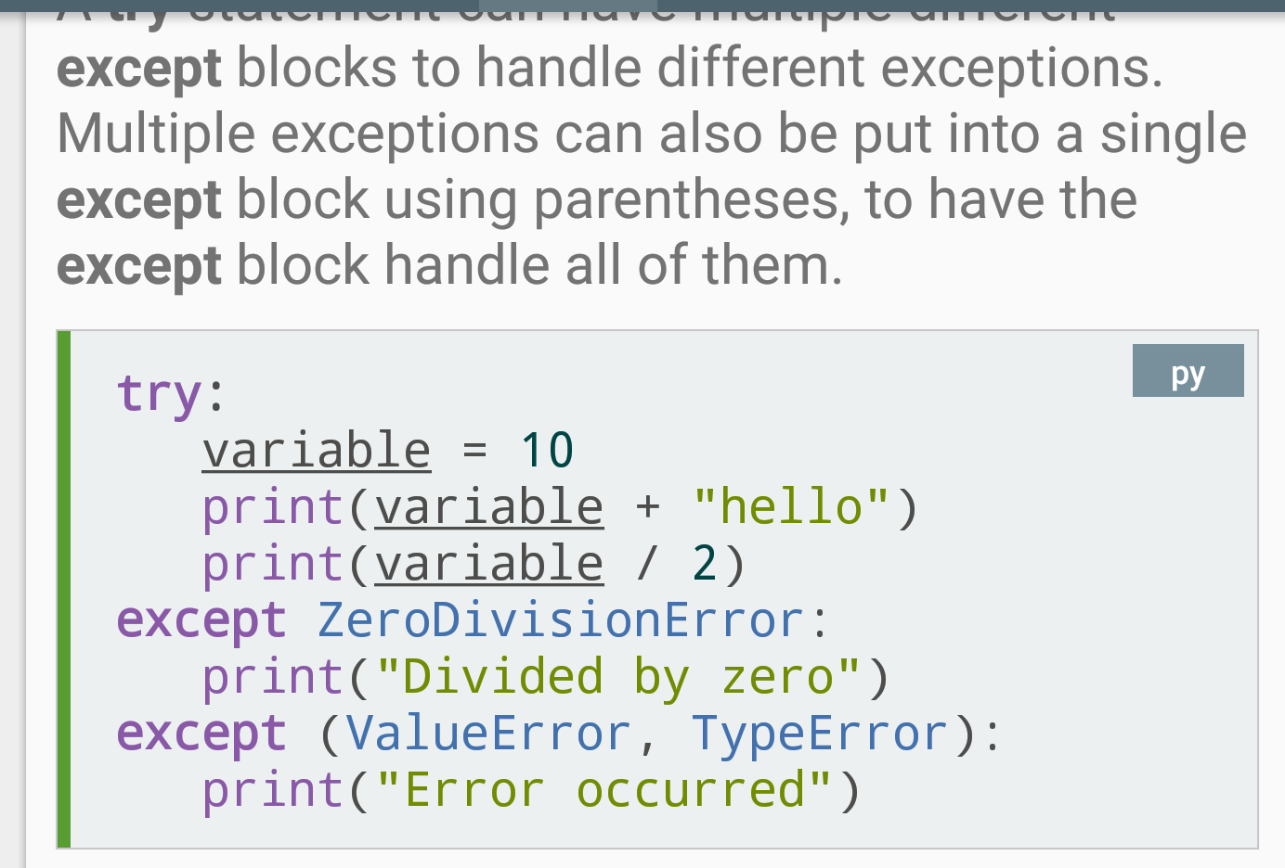
Logs for Vertex and Quadratic Calculators
10 Oct.
Created flow charts for Vertex form converter and Quadratic Calculator. Also reviewed procedures for completing the square.
27 Oct.
Finished debugging and making sure the Vertex Form Converter works properly. Added extra features to find slope given coordinates, x – intercepts, and y – intercept.
20 Oct.
Had trouble with Python's "Classic division", researched and learned how to use "division" function from __future__ module to get accurate numbers.
25 Oct.
Finished debugging and coding the Quadratic Formula Calculator
16 Oct.
Learned about the square root function under the Math module and learned how to use Exception Handling for the Quadratic Calculator.

Slide 6
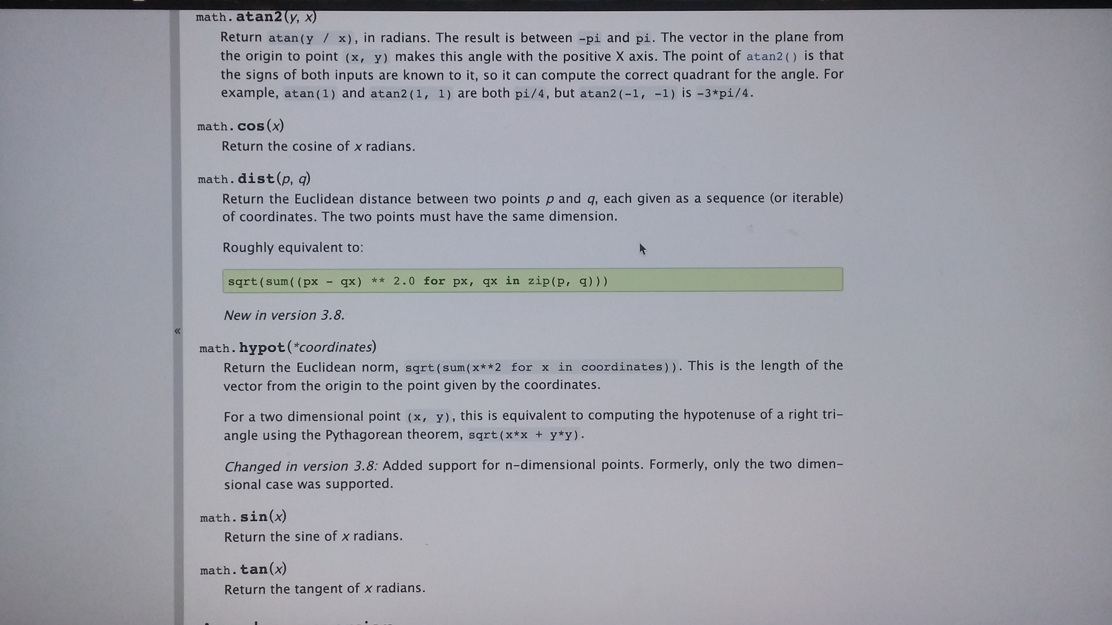
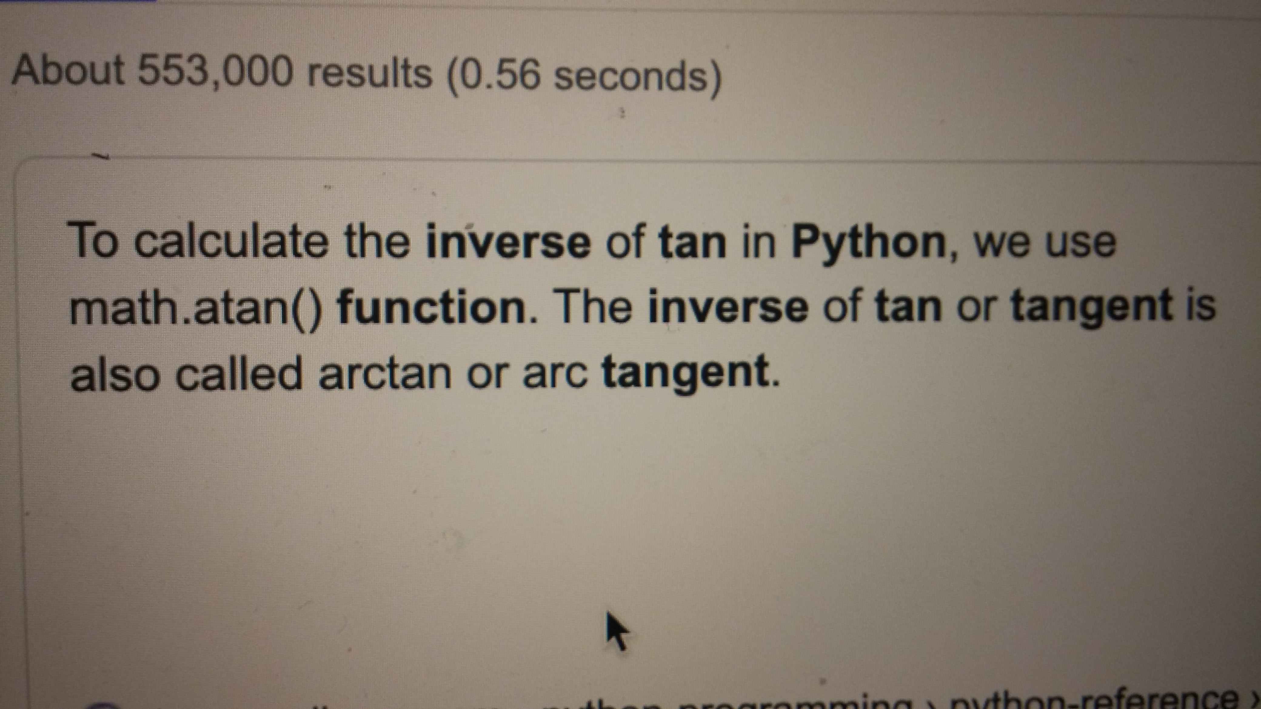
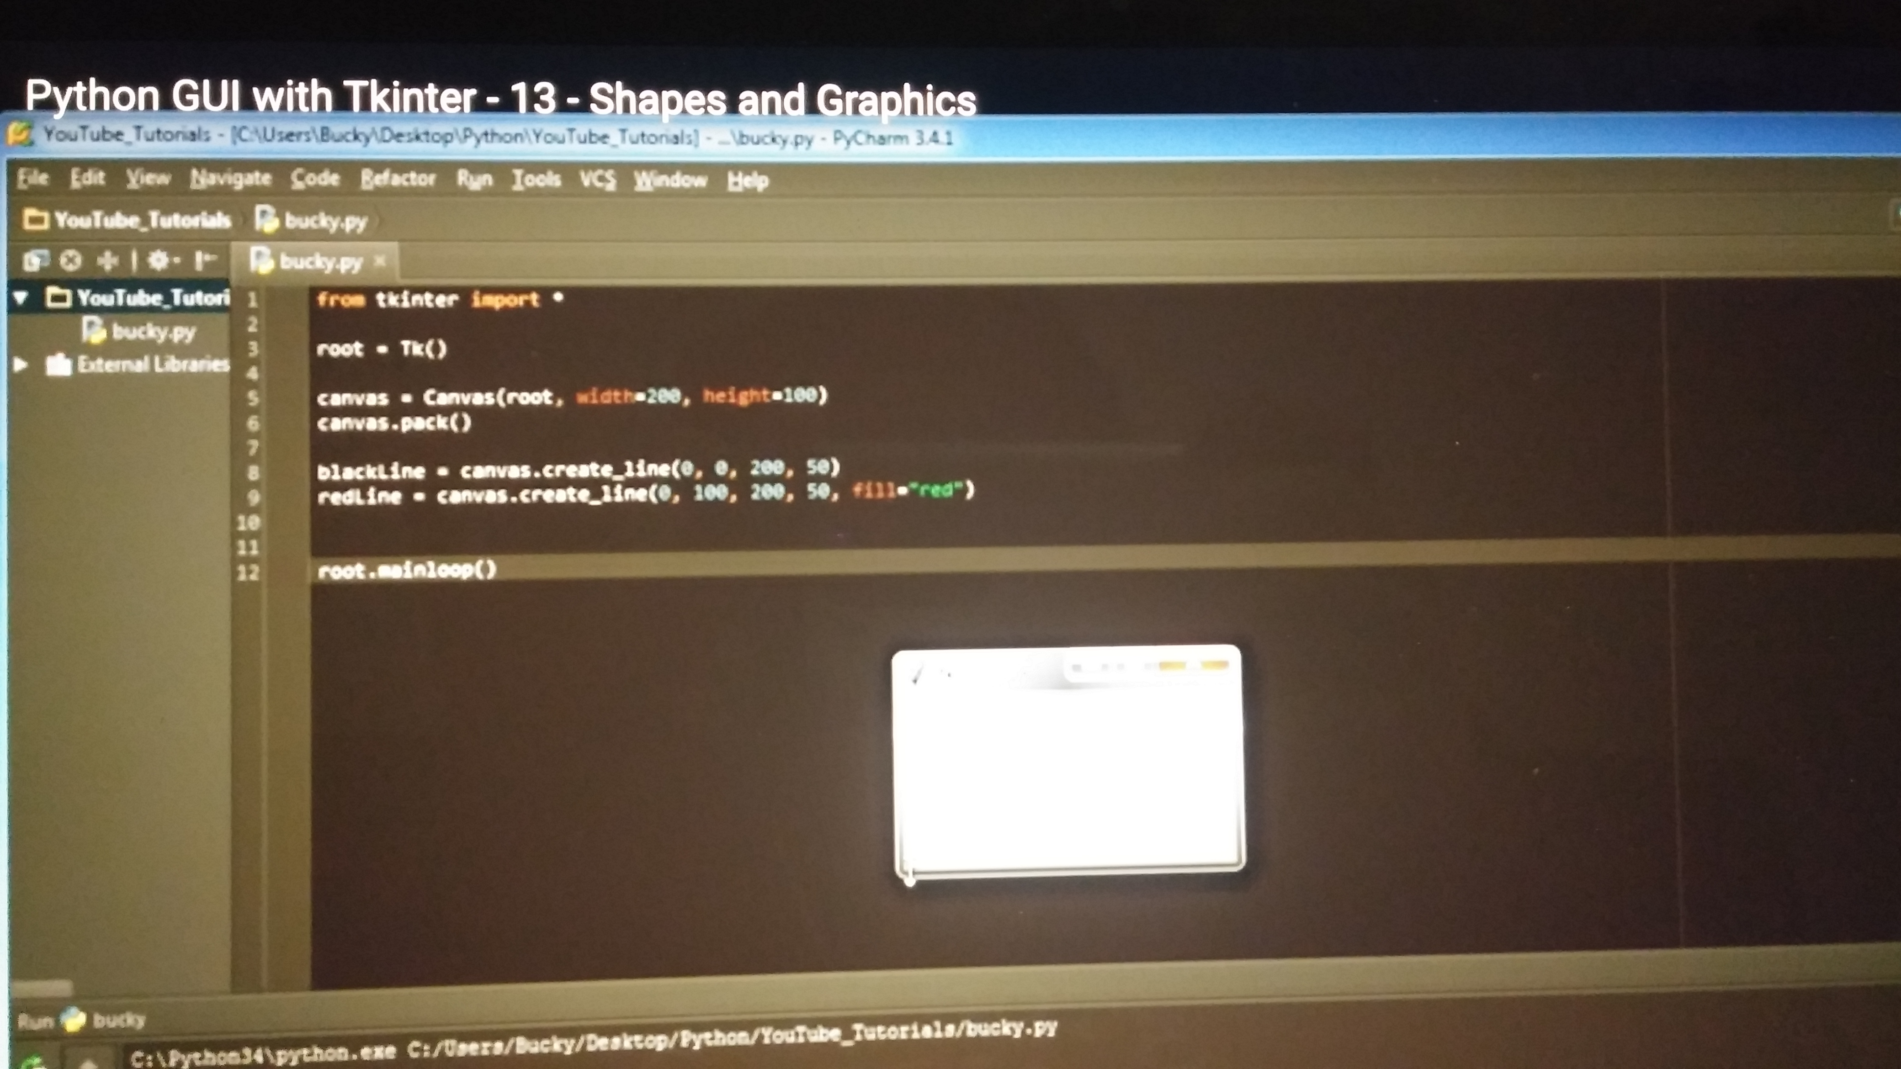
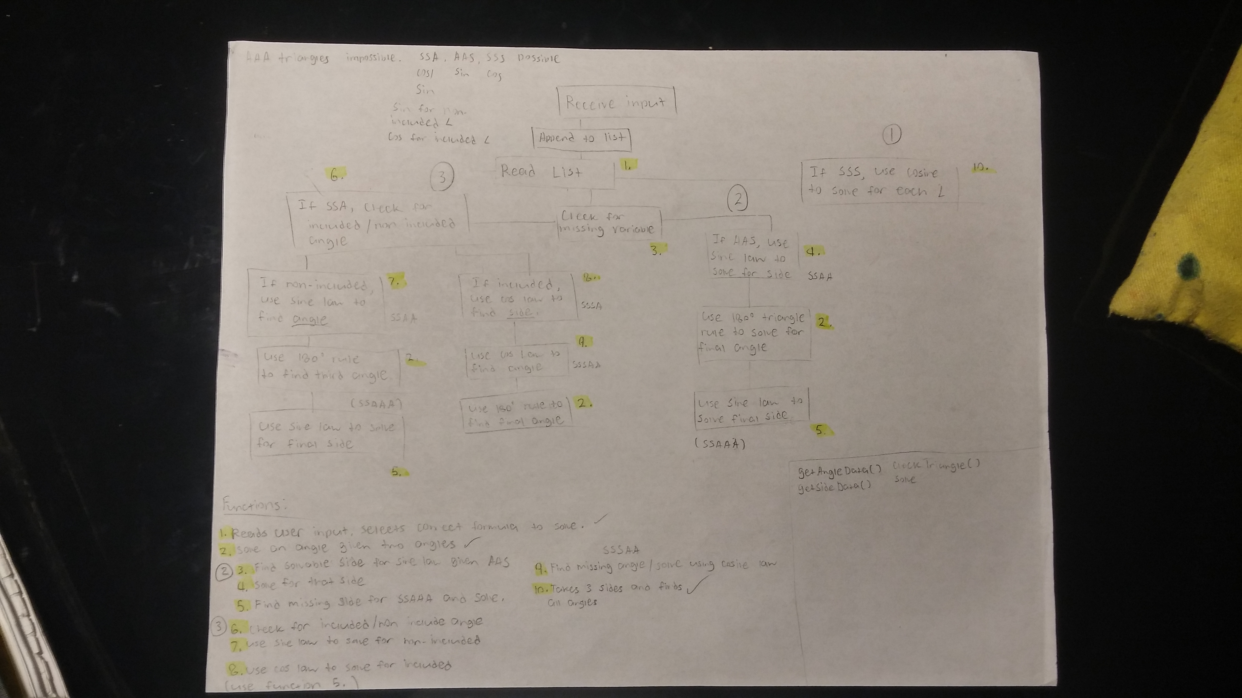
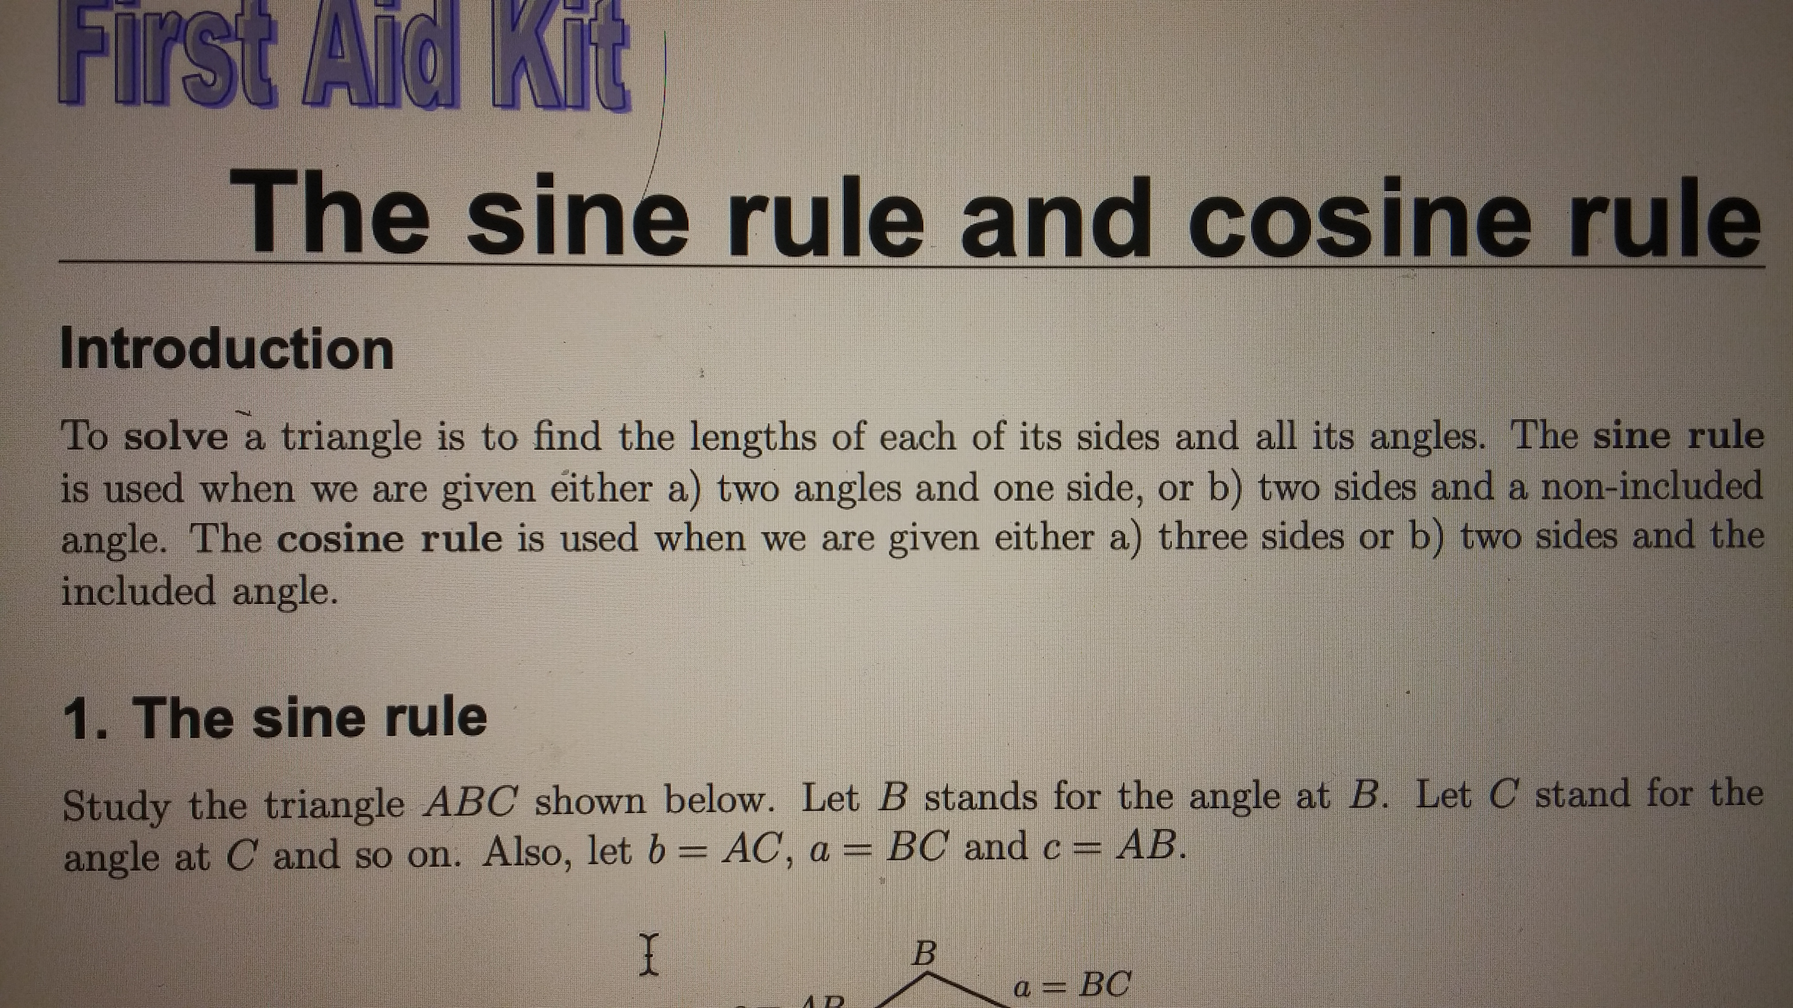
Logs for Triangle Solver Program (1/3)
Researched and found trigonometric functions under the Math module that can return an answer in radians on the Python official website.
6 Oct.
2 Nov.
Reviewed how to use cosine and sine laws to solve triangles (SSA, SAA, SSS), and developed a rough flow chart for program.
5 Nov.
Learned about arc tangent, arc sine, and arc cosine functions that can be used to find the angle of a trigonometric ratio.
11 Nov.
Expanded on the program design by mapping out functions that the program can use to solve various triangles.
18-23 Nov.
Taught myself how to make a GUI using the Tkinter module from videos on Youtube.

Slide 7
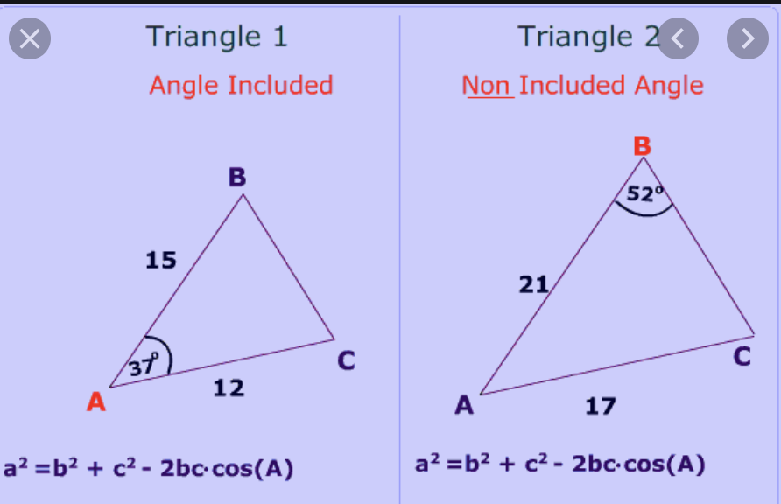
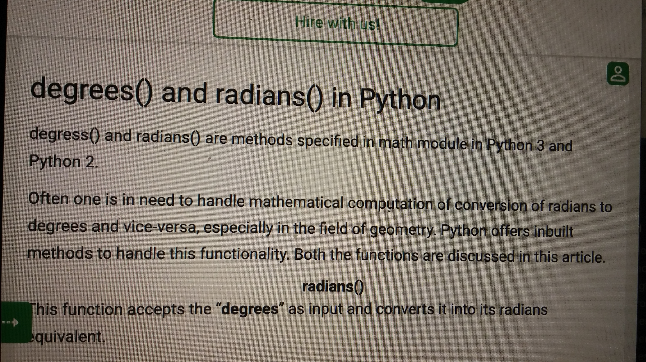
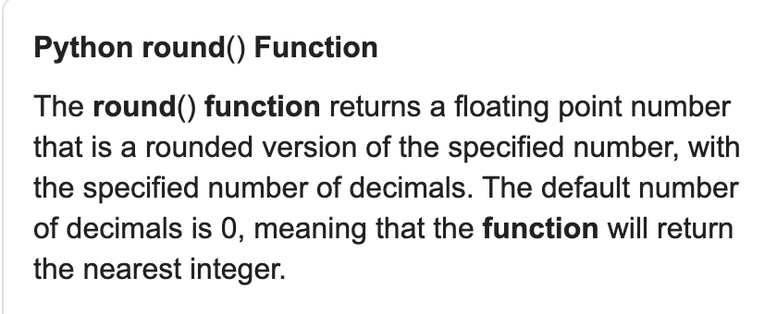
Logs for Triangle Solver Program (2/3)
Code didn't work properly, figured out a way to turn a function's input into a list rather than a tuple.
23 Nov.
Added more detail to program's flowchart and learned about non-included and included angles when solving SSA triangles.
1 Dec.
Learned about degrees() and radians() functions which can be used to convert degrees to radians and vice versa.
2 Dec.
3 Dec.
Learned how to use the round() function in Python.
5 Dec.
Ran into a very tedious bug, Python's sin() and cos() functions only work in radians and my code was using degrees.

Slide 8
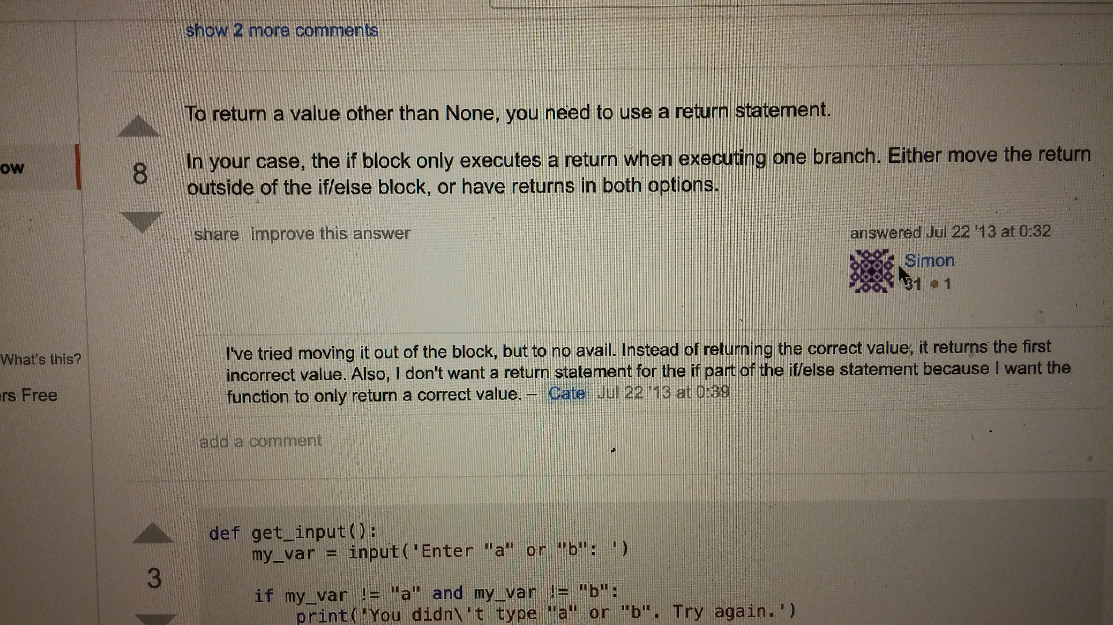
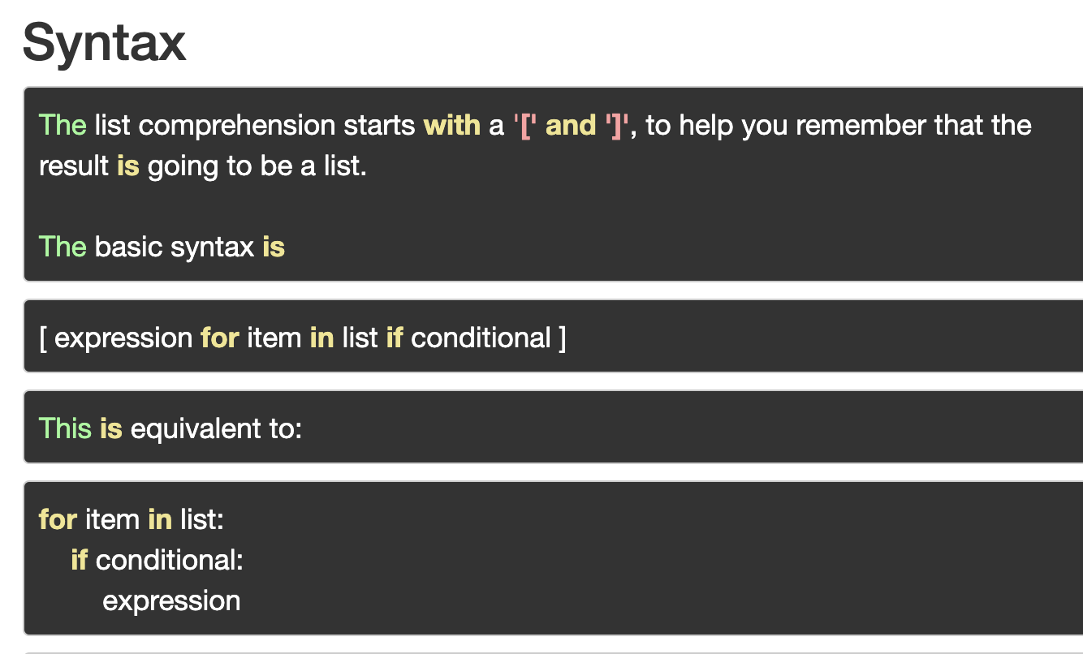
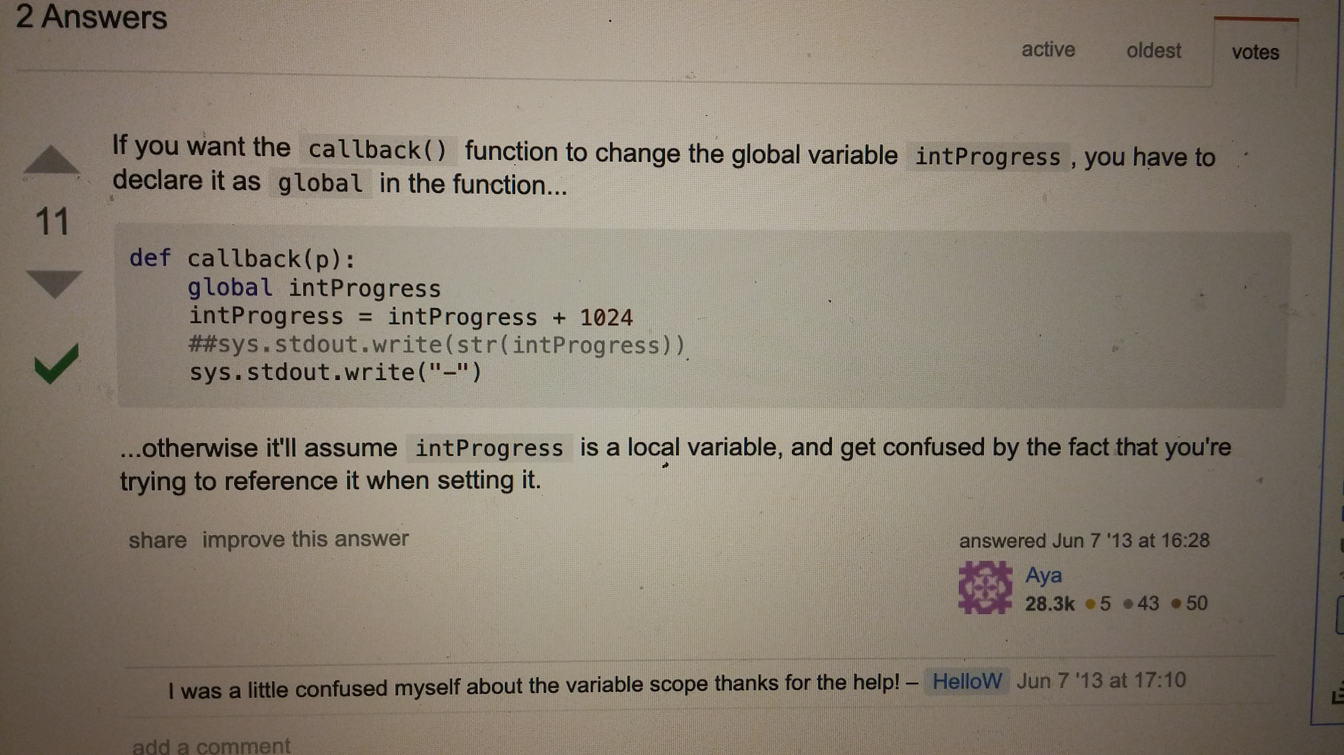
Logs for Triangle Solver Program (3/3)
6-7 Dec.
Spent over 15 hours coding and debugging over the weekend.
11 Dec.
Learned how to reference a global variable inside a function and solved a bug by learning that you always have to return a nested function.
12 Dec.
Finished creating a program that accounts for every possibility to solve any triangle with 3 data points and at least one side.
11 Dec.
When packing a widget in Tkinter, you have to pack it separately on a new line or else creates a "NoneType".
11 Dec.
Learned how to use "list comprehension" to iterate through a list and overwrite its elements.

Slide 9
Goals
Goals Word Document

Slide 10
Resume and Cover letter
Dropbox link

Slide 11
Reference Letters
Dropbox link

Slide 12
Final Reflection
Capstone Final Reflection

Slide 13
Core Competencies
Personal Stories Assignment
Self Assessment of Core Compentencies

